Slide 1
Studying self-help in Germany – challenges and obstacles in self-help oriented research
Christopher Kofahl, PhD
University Medical Center Hamburg-Eppendorf
Department of Medical Sociology
Working Group on Patient Centredness and Self-Help
Martinistr. 52
20246 Hamburg
kofahl@uke.de

Slide 2
Self-Help Research in Germany
Research with whom?
Research by whom?
Research about what?

Slide 3
Research with whom?
The wide scope of self-help …
SHG = self help group in the meaning of …
  mutual support and help between peers,
  usually face to face,
  mostly on a regional level,
  mainly aiming at individual and/or local solutions or improvement in daily affairs
SHO = self help organisation in the meaning of …
  indication based patient collectives,
  usually (semi-)professionally organised using a wide range of communication technologies
  mostly on a supra-regional level
  mainly aiming at collective affairs like quality improvement in care, political representation and influence, inclusion and integration, arising awareness, knowledge and information

Slide 4
Research with whom?
The wide scope of self-help …
SHA = self help alliances in the meaning of …
  supra-indication based umbrella organisations of SHOs
  usually professionally organised using a wide range of communication technologies supported by qualified professional staff
  national and international level
  aiming at political participation and integration
  delegating patient representatives
SHSS = self-help support system
  about 300 clearing houses on self-help, offices of the welfare organisations, independent patient counselling offices, (health) consumer organisations etc.
  regional and national level
  aiming at supporting SHGs and patients’ interests

Slide 5
Research by whom?
Who is conducting self-help research in Germany?
Universities and Universities of Applied Sciences
  just a few working groups primarily in the fields of medical sociology/psychology, political science, social law and social management and social work
  problem: self-help research is unattractive for many researchers – difficult to conduct, difficult to get funds, difficult to publish
Self-Help and Patient Organisations
  many of the bigger SHOs are running own research activities, often in co-operation with research institutions
  problem: research work is often underfunded, research designs are often limited compared to scientific standards, publications are usually in German only and often self-published, therefore difficult to find

Slide 6
Research by whom?
Who is conducting self-help research in Germany?
Clearinghouses for Self-Help
  different and manifold research activities on specific topics, smaller studies or socio-political reflections etc.
German Working Group for Self-Help Groups (DAG SHG)
  DAG SHG is stimulating scientific contributions towards self-help activities (e.g. regular conferences, the Yearbook Self-Help Groups)
National Clearinghouse for the Encouragement and Support of Self-Help Groups (NAKOS) in Berlin
  NAKOS is the centre for aggregated data on SHGs and SHOs, is running own research projects on actual topics (e.g. “Younger people in Self-Help”, “Self-help through the internet”, “Patient Centredness” etc. -> regular publications, e.g. “NAKOS info”)

Slide 7
Research about what?

Slide 8
Why Self-help Research?
The main focus:
Patient-
-involvement, -participation, -integration, -inclusion, - …
between
Solidarity ← and → Subsidiarity

Slide 9
Why Self-help Research?
4 Theses of patient participation and integration
SHOs, SHGs and patients are provided with necessary opportunities and resources to be able to contribute to political decision making (thesis of empowerment).
SHOs, SHGs and patients are offered “placebo participation” to present their views, but without relevant rights or chances to really influence policies (thesis of pacification).
SHOs, SHGs and patients are encouraged to provide other patients with information and advice. Are SHGs and SHOs at risk to become a substitute for cut health care services? (thesis of instrumentalisation).
SHOs and SHGs are acting below their potential capacities due to lacking resources and administrative barriers (thesis of brain and resources waste).

Slide 10
What?
Here a long list of research questions…

Slide 11
What?
Also: Effects? Efficacy?? Effectiveness???
In which areas and dimensions can SHG and SHO be effective at all?
If they can be effective, what are the relevant outcomes, and who is defining those?
Are SHG- and SHO-activities and results “measurable”? What are the measures? Are these - in terms of EBM - comparable at all? Is the RCT an adequate research design for self-help research? And - if not -, is this acceptable for decision makers?

Slide 12
Finally, some advertising…

Slide 13
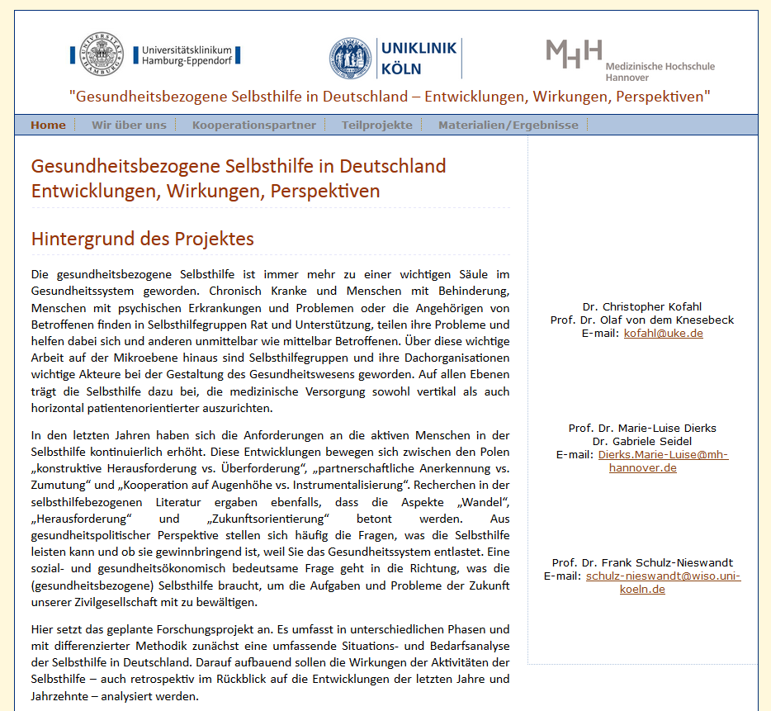

Advertising
Draft! To be launched soon…

Slide 14
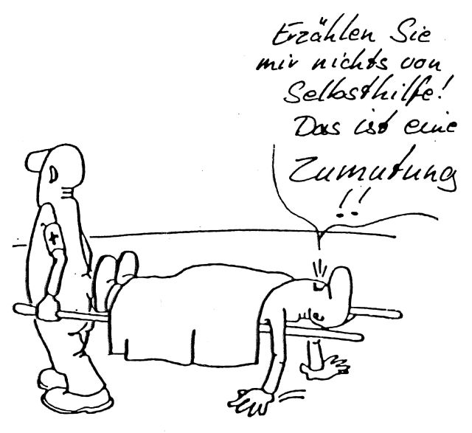
Thank you for your attention!
Don‘t talk about self-help! This is unacceptable

Slide 15
Why Self-help Research?
Health related self-help is an important measure to promote patient centredness and individual health literacy in patients
Peer to peer counselling and advice is the more important the less professional counselling can/will be offered and the more the complexity of coping with a disease increases
Are SHGs and SHOs at risk to become a substitute for cut health care services?
Surprisingly little is systematically known about aims, challenges, demands and activities of health related self-help groups and associations

Slide 16
What?
What are the origins, structures, resources and internal dynamics of SHGs, SHOs and their umbrella organisations?
Which policy contexts are SHOs facing / confronted with?
Which relationships and collaborations with other healthcare stakeholders do exist? Are they fruitful or frustrating?
What are the aims and future prospectives of SHGs and SHOs?
What do SHGs and SHOs need to exist and to expand?
What kind of responsibility do SHGs and SHOs have to bear? Do they have responsibilities? …

Slide 17
How?
First of all: Participative Research!
Secondly, method mix: (qualitative, quantitative, health policy research, case studies, action research,…)
Decide with whom
Decide on what
Decide how in detail

Slide 18
Research by whom?
Who is conducting self-help research in Germany?
Foundations (e.g. Deutsche Krebshilfe)
Welfare organisations (e.g. PARITAET, VdK, …)
Federal Association of Statutory Health Insurance Physicians
Statutory Health Insurances
…

